Slide 1
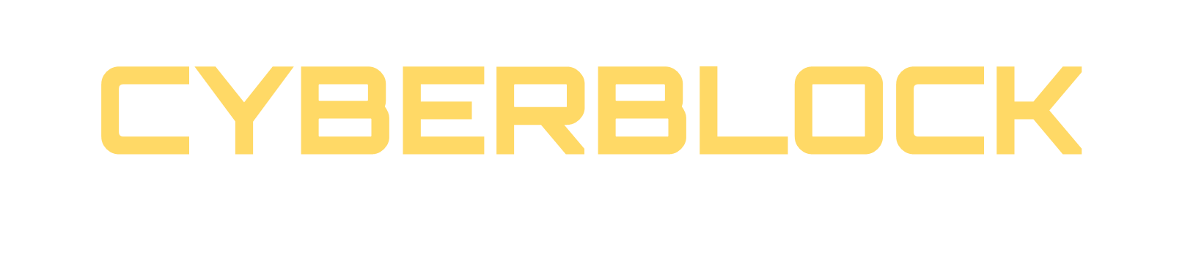

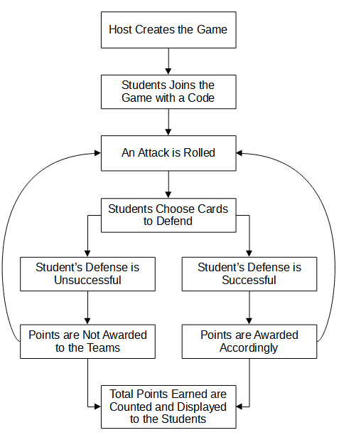
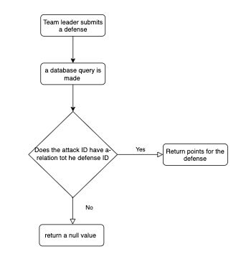
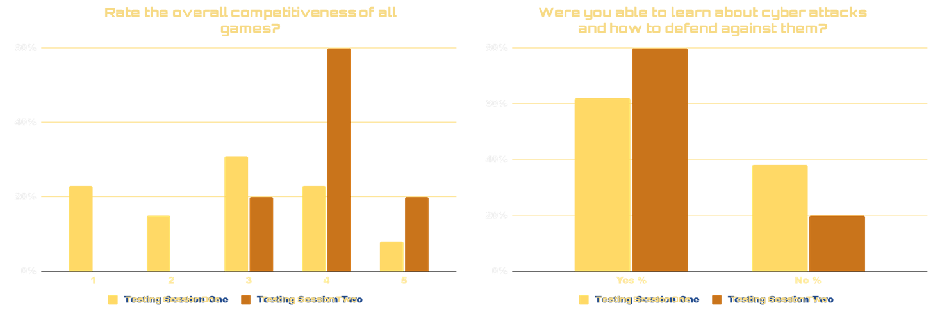
Would you believe me if I told you that your loved ones medical devices could be hacked at any moment?
ABSTRACT
METHOD/APPROACH
What if I told you that your pacemaker could be hacked at any moment? Medical device manufacturers, healthcare providers, and regulators are increasingly facing issues with the security of medical devices. While it can be simple to make medical devices more secure, the trade-off is the loss of efficiency. CyberBlock started as a card game created by Ben, Tram, and Jeannine who are members of Medtronic. The purpose of the game is to train people in the medical device industry in cybersecurity and improve their strategic decision-making used to defend against real-world cyber-attacks. The team at Medtronic tasked us with creating a web-based version of CyberBlock. Our digital version expands on the physical card game with new features and the ability to play remotely, allowing people all over the world to participate. Without the limitation of physical cards, the attacks and defenses can be kept up to date with current real-world cyber threats. The computer-based game will have features to allow teams to purchase security defenses for their devices using limited resources. Hosts will create game lobbies that users will be able to join using a game code. The users will then face off against cyber-attacks with their purchased defenses. If the team can fend off the attack, whether from eliminating or remediating the attack, they will be awarded points. At the end of the game, the team will be able to view the number of points received through a scoreboard.
When designing this program, we followed several important principles to ensure a quality product that meets clients' requirements.
First, throughout the design process, we worked to maintain a focus on keeping the application as similar to the paper-based version as possible. We did occasionally consider some extraneous features, but we regularly asked ourselves (as individuals and as a team) “Is this straying too far from the original design?” We used this principle to eliminate unnecessary features while giving the game a modern approach through computer adaptations.
Next, we also needed to consider functional requirements set by the clients and the future implementations of the program. To make sure that we had all requirements prioritized, the team examined the paper-based version thoroughly to ensure that the implementation of a computerized version and the requirements matched. We also considered how the game would be able to change with the addition of new attacks and defenses.
In addition to these two guiding principles, we tried to keep in mind certain design priorities according to information we gathered from the clients. As such, we tried to prioritize a functional program for the first half of the project. Designing and making the program aesthetically pleasing to the users will be implemented in the second half of the project.
PURPOSE
CONCLUSION
The purpose of the CyberBlock game is to engage students and workers involved in the medical device security field by having users purchase upgrades and defenses in a game environment that could potentially stop cyber-attacks similar to situations that they would face in the real world. With a web-based version of the game, participants will learn how to counter cyber-attacks using defenses that could be implemented into medical devices and from the interactions, we hope to provide an enjoyable experience for the players.
Medtronic will primarily use the application in training its new hires against real-world cyber threats. The server will eventually be taken off the free version of the Heroku platform and migrated to the internal Medtronic server for more robust security. By 2022 people across Medtronic will have access to CyberBlock. While many of the features were implemented into the CyberBlock game, there are more improvements that can be done. Examples of future improvement involve:
Proper countermeasure against web attacks.
Handling reconnection.
Accommodate refresh.
Inclusive of all three tiers of difficulty mode.
Add Accessibility.
Enhance UI with animation.
Add Google Analytics to track traffic.
Addition of more attacks and defenses to the database.
RESULTS
TARGET AUDIENCE
The game is designed for students learning cybersecurity principles and the cost-effectiveness of defenses in relation to modern cyber-attacks. The CyberBlock game is independent and self-contained. Cyber security instructors will be able to create game lobbies where users can join the game and play along. The game’s purpose is to train students or employees how to manage and prepare for cyber security risks via defenses and learn which defenses work well against which attacks.
The users of the game are divided into two categories: beginner, intermediate and advanced players. The beginner's category will have reduced card sets based on the attack score below five. The difficult mode will have all the cards set. The beginner user’s interface will have the least number of card sets and the advanced level users will have the greatest number of cards. The attacks will have difficulty as an attribute to determine whether the attack is beginner, intermediate or advanced level attack.
REFERENCES
“Mitre ATT&CK.” MITRE ATT&CK, The MITRE Corporation, 2021, https://attack.mitre.org/.
“D3fend Matrix: Mitre D3FEND.” D3FEND Matrix | MITRE D3FEND, The MITRE Corporation, 2021, https://d3fend.mitre.org/.
“General Cyber Security Taxonomy”, University of Kent, 2021, https://cyber.kent.ac.uk/research/cyber_taxonomy/app/taxonomy/visualization?t=space_tree&n=Cyber%2BSecurity&st=true&nid=39.
“Common Attack Pattern Enumeration and Classification.” CAPEC, The MITRE Corporation, 25 Feb. 2021, https://capec.mitre.org/.Tram-Anh Cai.“CyberBlock Components”, Medtronic, 09/09/2021

Slide 2
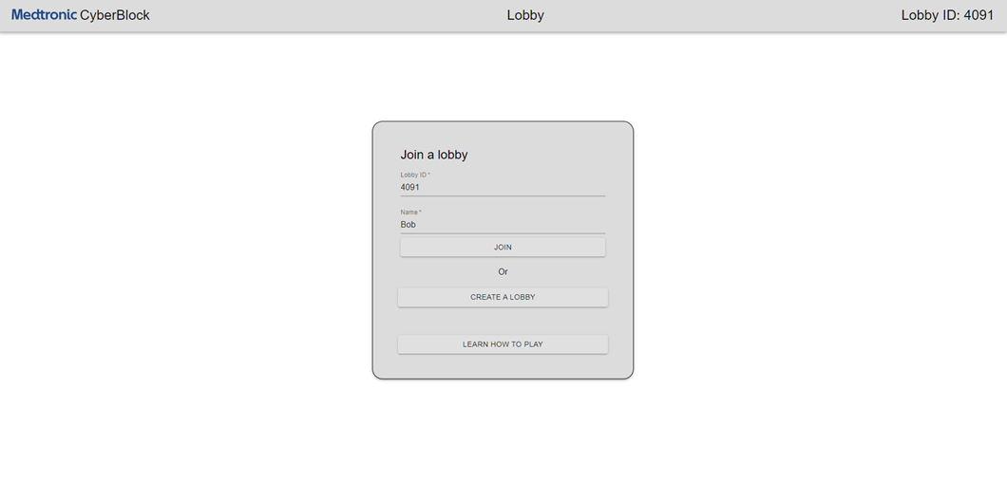
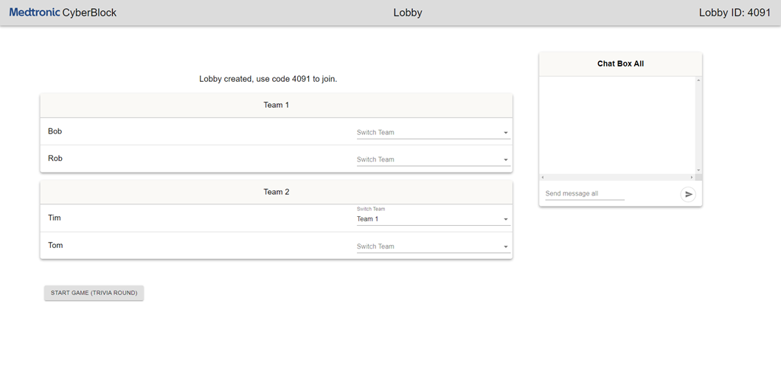
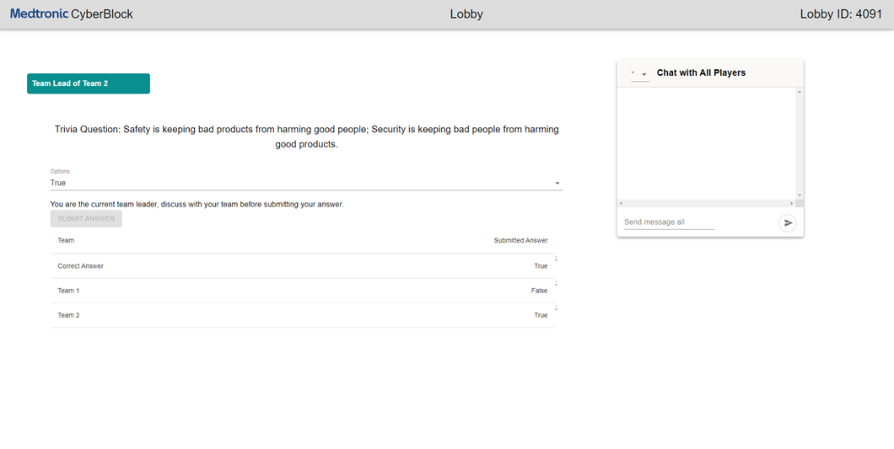
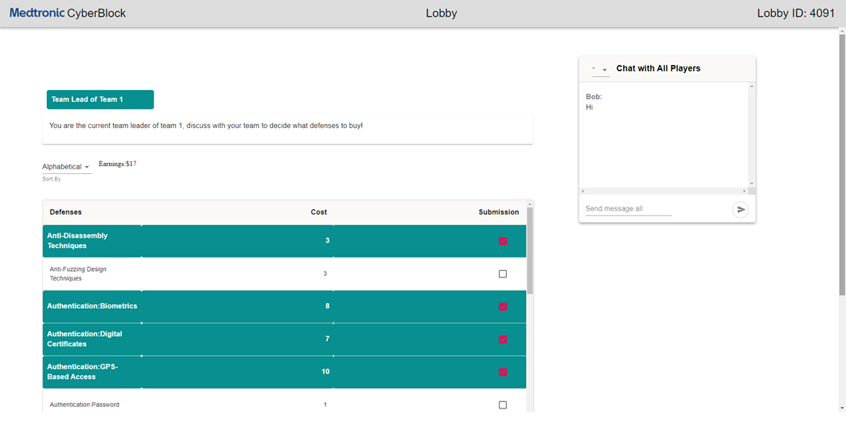
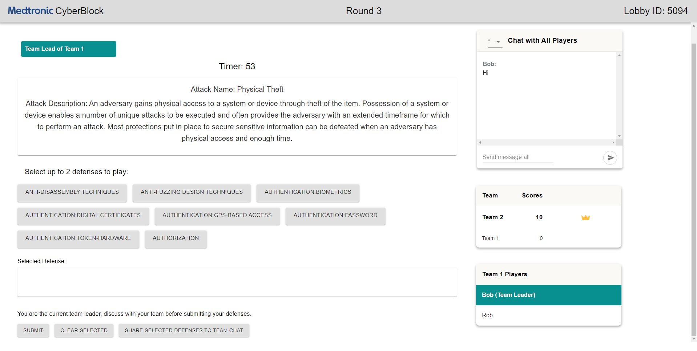
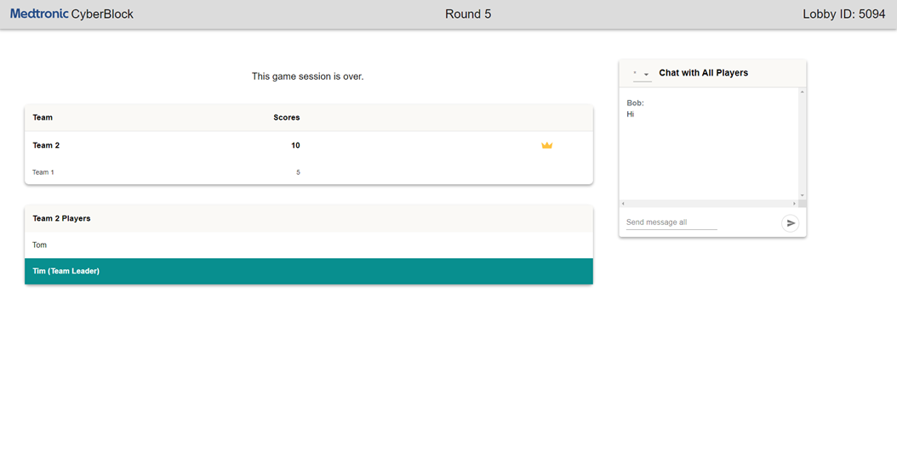
Interface and Gameplay Examples
LOBBY
TEAM SELECTION
TRIVIA ROUND
BUYING DEFENSES
GAMEPLAY
SCOREBOARD

